Slide 1
ACE The Media Difference Between Left and Right Wing
Zejian Lyu, Yutong Jiang, Qichang Zheng, Kekun Han

Slide 2
Our Research
Research Question: how does left-wing media and right-wing media differ in ideology and contents they report among topics that involve physical conflicts and topics that are not?
Content Difference: difference in coverage of events under the same topic
Ideology Difference: difference in judgment, word choice and implicit arguments within articles under the same topic
Physical conflicts topics: Ukraine, War, Violence, Crime, Police
Non-physical conflicts topics: Republic, Democratic, LGBT, China, Fair

Slide 3
Data Sources
Scraped Data Source:
New York Post (newspaper)
The Spectator (magazine)
The Federalist (magazine)
API Data Source:
CNN
Fox News
TheBlaze (media company)
The Daily Caller (news and opinion website)
Advantage:
News articles are great sources to detect media bias
Have an enormous amount of data
Disadvantage:
Results are highly depend on the topic we choose
Missing some large news outlets such as ABC, NBC, New York Times

Slide 4
Data Collection
Left Wing: CNN (9000 articles per topic)
Right Wing: New York Post (10000 articles per topic) and the others (2000 articles per topic)
Searching each topic in the search tab in each news website by relevance
Crawling the web links of every article
Scraping articles using the web links

Slide 5
Data Collection: Problems
1. Can only get the articles in the first page of the searched results. No direct access to the articles beyond the first page
Solution: Find the access to the API of the search page and use the API to find the weblinks to each article
2. Memory error when crawling and scraping the articles
Solution: Save 100 articles a time and clean the memory after one save.

Slide 6
Data cleaning and wrangling
During web-scraping and crawling:
Extract the publish date of each article and standardize the date format (y-m-d) before saving (using the datetime package)
Remove the duplicates and NaN values
For the entire analysis:
Remove the stop words (stop words come from nltk package and some are created by ourselves)

Slide 7
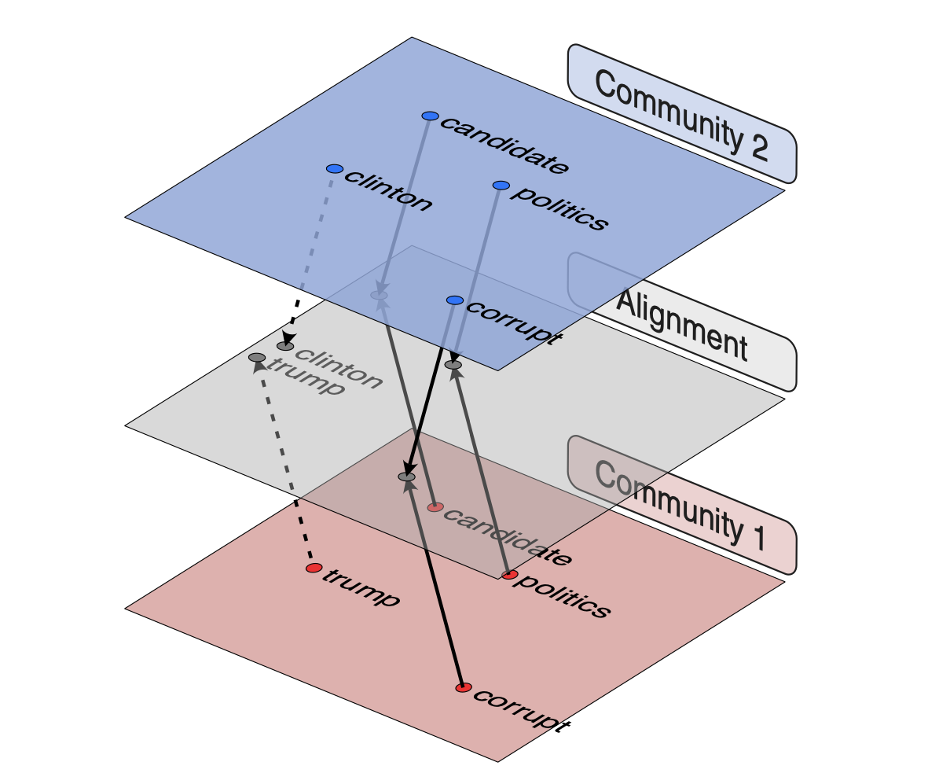
Model
Train separate embedding model on left-wing corpus, right-wing corpus, and combined corpus (to get democratic context, conservative context and general context).
Use general word-embedding vector to cluster contents.
Train cross-lingual translational model to align left and right context to general context, by stop words.
Measure the content coverage and ideological context difference by content clustering and contextual mapping.
Content coverage: JS divergence between word percentage on each cluster.
Ideological context: negative cosine similarity between the same word from 2 embedding.
Method and picture from:
Jeremiah Milbauer, Adarsh Mathew, and James Evans. 2021. Aligning Multidimensional Worldviews and Discovering Ideological Differences.

Slide 8
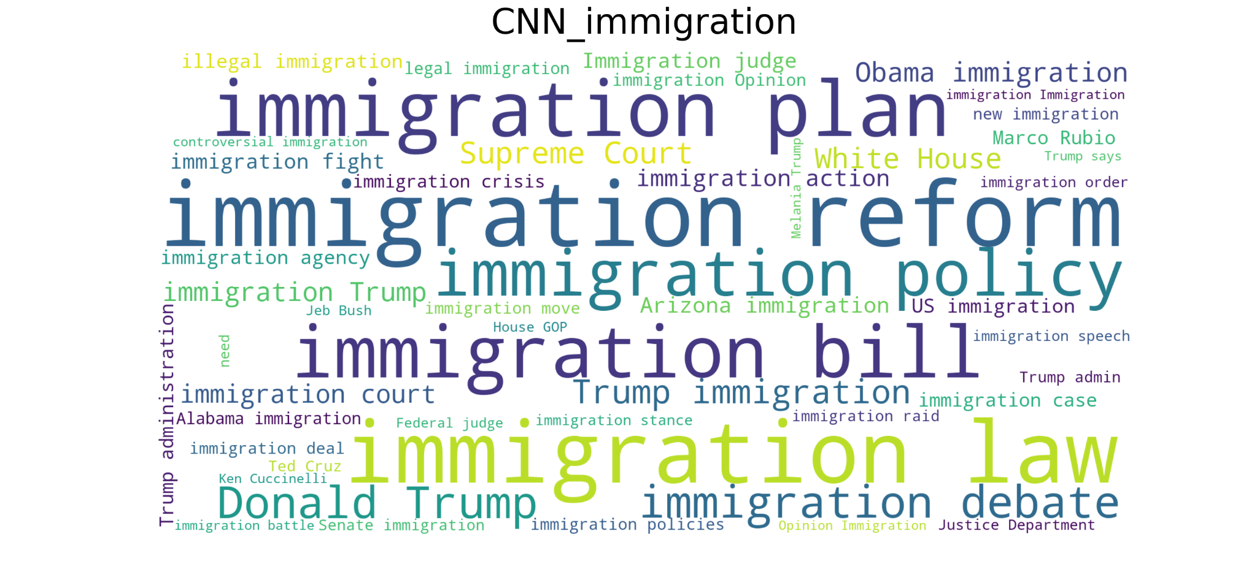
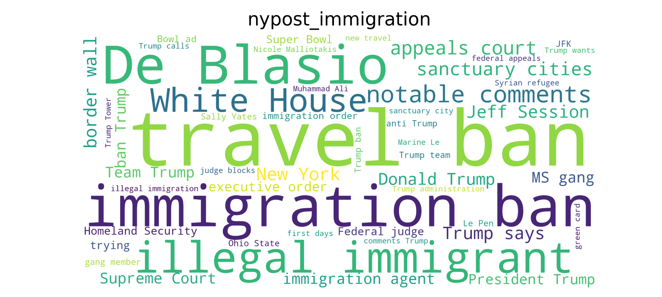
Some Preliminary Results

Slide 9
Steps
Use LDA model to reflect content differences
Use word associations to reflect ideological differences
Main result use JS divergence and negative cosine similarity to model war topics, violence topics, and other topics’ extent of content and ideology differences

Slide 10
Topic Modeling to analyze content differences
Use Gensim Latent Dirichlet Allocation (LDA) to topic model for each keyword (aka topic) with generated articles from CNN and New York Post to learn the topic distributions and word distributions that best explain these collection of articles
For each keyword, model five topic clusters using searched articles
Visualize topic clusters to see if each media report the same topic differently, such as different topic clusters within each keyword and usage of words
War: Ukraine
Non-war violence: Gun
Other: Democratic and Republic
Notes:
next we used gensim lda model to find out two medias topic distributions for each keyword
for our purpose, we selected one war related keyword which is ukraine, one non war violence keyword, which is gun, and two other keywords democratic and republic

Slide 11
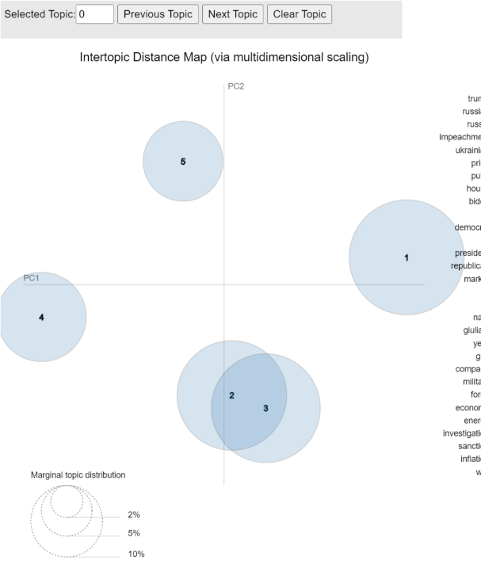
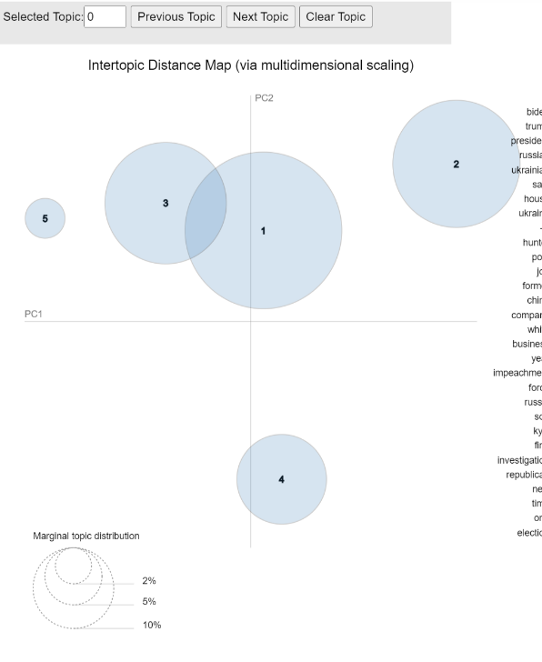
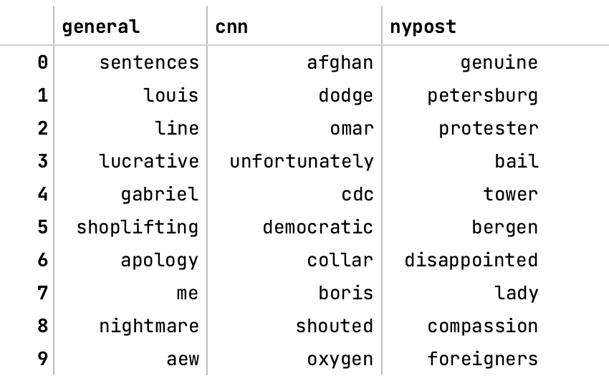
Topic Visualization: Ukraine
Coverage differences vs ideological differences
Association of “Ukraine” by general (combined articles), CNN and nypost to reflect ideological differences
CNN
Cluster 1 (government): Trump, impeachment, house
Cluster 2 (Russia and Ukraine): Russian, Ukrainian, force
Cluster 3 (economy): price, market, gas
New York Post
Cluster 1 (economy): biden, inflation, price
Cluster 2 (Russia and Ukraine): Russian, Ukrainian, force
Cluster 3 (government): Trump, impeachment, president
Notes:
for ukraine, we can see there are not a lot differences in topic coverage between two media, all concerns government, the war and economy; on the right is the association direction of general, cnn and nypost, these distinct words show the different associations of ukraine that cnn and nypost produce

Slide 12
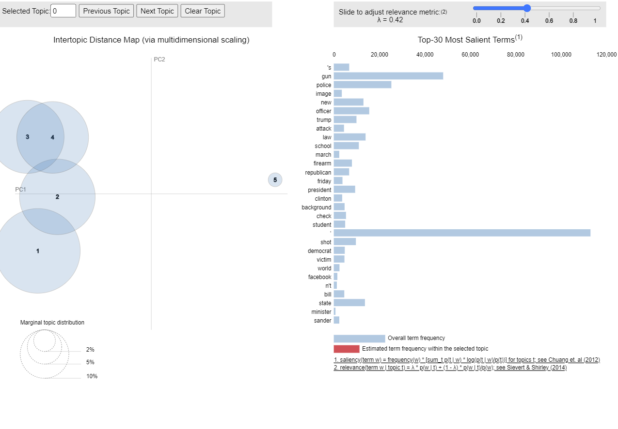
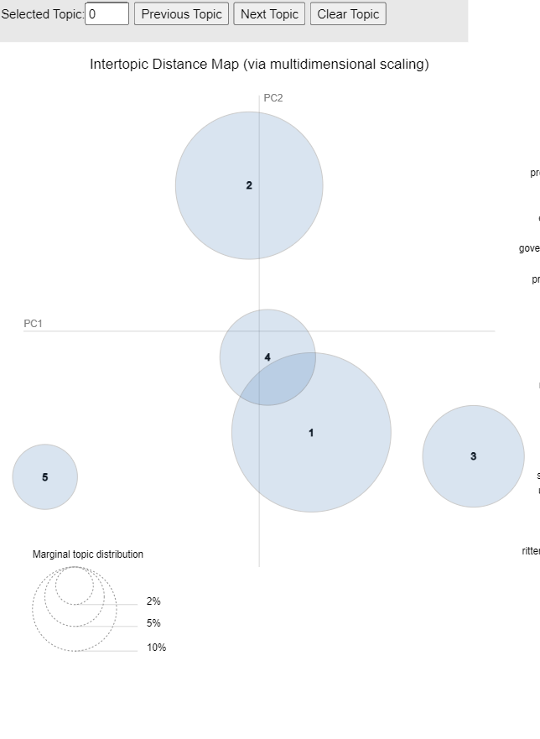
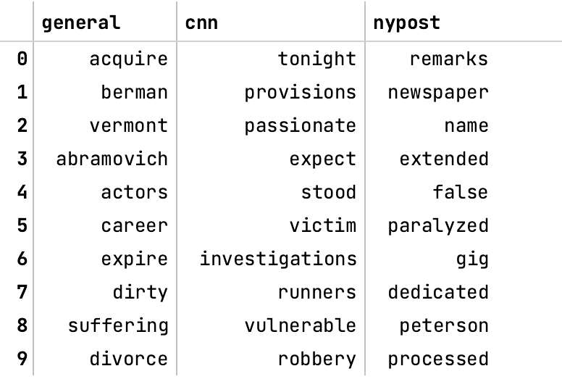
Topic Visualization: Gun
Association of “Gun” by general (combined articles), CNN and nypost to reflect ideological differences
Associations are different but not as apparent as in “ukraine
CNN
Cluster 1 (crime): police, shot, suspect
Cluster 2 (school shooting): school, student, shooting
Cluster 3 (gun law): gun, law, background
New York Post
Cluster 1 (school and government): school, Biden, state
Cluster 2 (law enforcement): police, protest, arrest
Cluster 3 (other law): roe, abortion, sport
Notes:
for gun, both media reported topic related to school shooting and law enforcement, but nypost also reported topics on abortion law, the associations of gun are somewhat different between medias not as apparent as ukraine

Slide 13
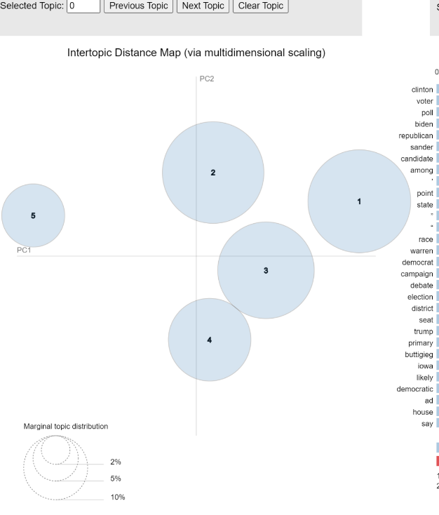
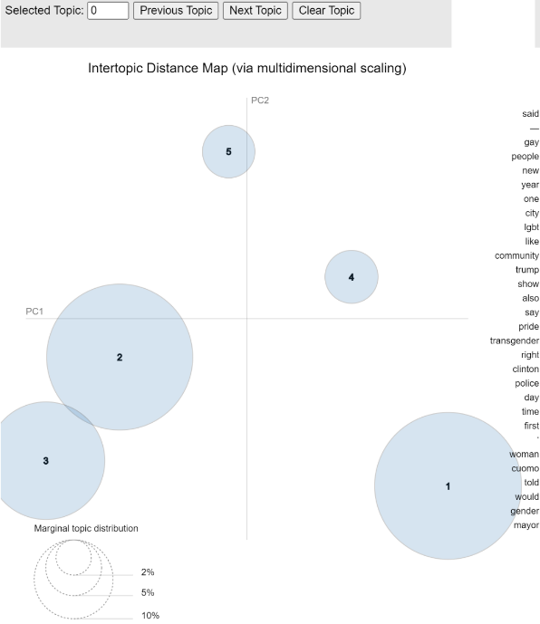
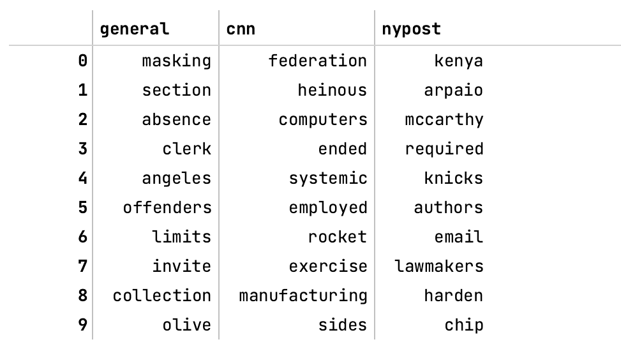
Topic Visualization: Democratic
Association of “Democratic” by general (combined articles), CNN and nypost to reflect ideological differences
Associations are similar even though topic coverage (on the left) is diverse
CNN
Cluster 1 (government): house, Trump, democratic
Cluster 2 (party): republican, state, election
Cluster 3 (president): Clinton, sander, Obama
New York Post
Cluster 1 (president): Trump, Clinton, president
Cluster 2 (human rights): gay, marriage, law
Cluster 3 (gender): gay, women, transgender
Notes:
for democratic, the topic coverage is diverse, nypost covered more gender and human rights issue. the association however is very similar

Slide 14
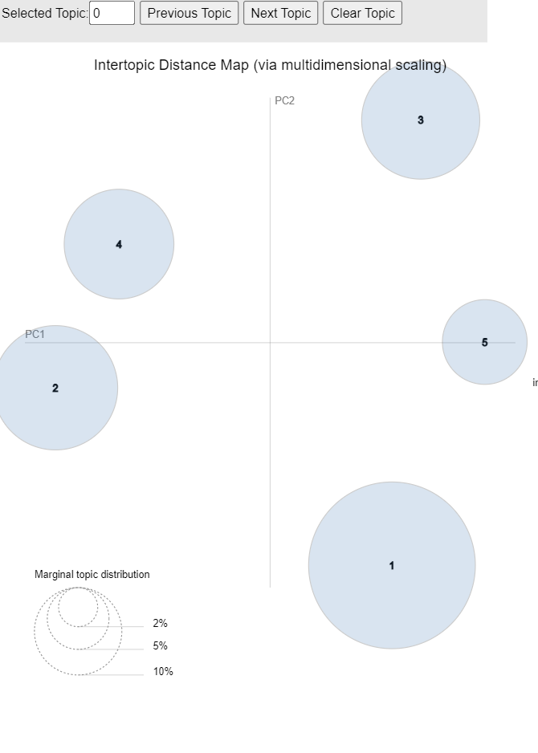
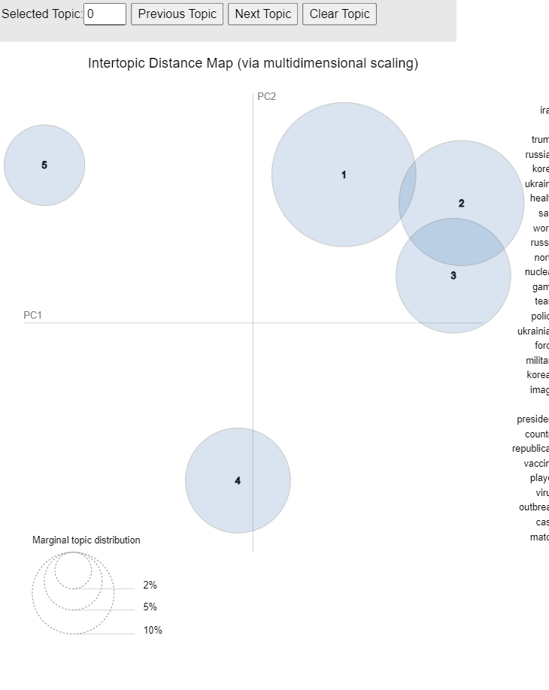
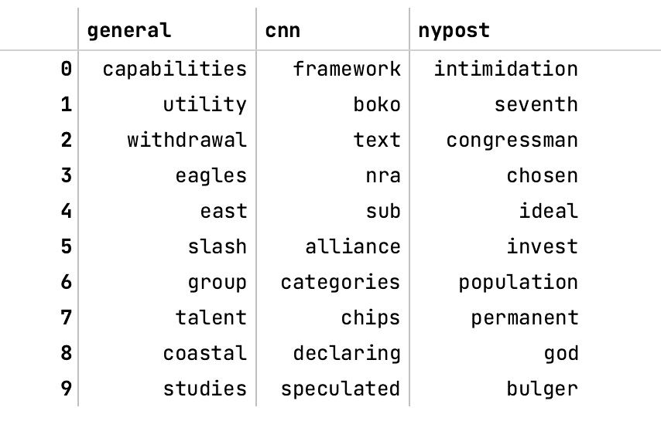
Topic Visualization: Republic
Association of “Republic” by general (combined articles), CNN and nypost to reflect ideological differences
Associations are different even though topic coverage (on the left) is similar
CNN
Cluster 1 (government): Trump, republican, president
Cluster 2 (foreign relations): Iran, Korean, north, nuclear
Cluster 3 (Russian and Ukraine): Russian, Ukraine, killed
New York Post
Cluster 1 (events): year, player, match
Cluster 2 (politics): Trump, democratic, election
Cluster 3 (Russian and Ukraine war): Russian, Ukraine, Putin
Notes:
republic, topic coverage similar, association is different

Slide 15
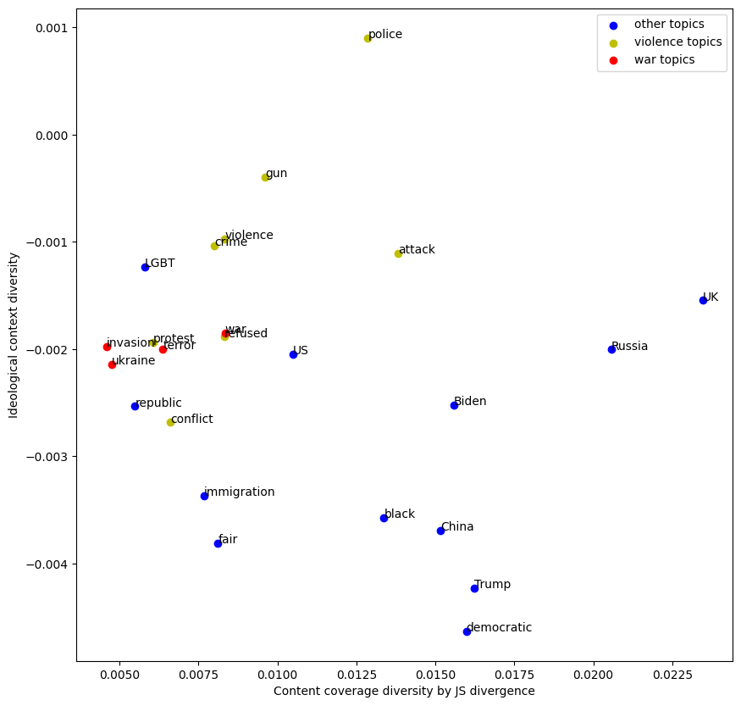
Word Embedding Result
Result is consistent with the lda models and word associations
we plot each topic on its JS divergence and negative cosine similarity
war topics are clustered together, which means they all have low content diversity and medium-level ideological diversity

Slide 16
Conclusion
Among all the topics , in physical violence related topic, left and right wing media have low difference in content coverage, but high difference in ideological context.
Within physical violence topics, we recognized that, war-related topics have significant similar characteristic. They have lower content difference, and medium ideology difference.
Other non-war violence topics tend to have low content diversity, but still higher than war topics, and high ideological differences
There is no apparent pattern among other topics. In our future research, we plan to apply more delicate topic classification, and gather more corpus.
But Democratic and Republic have the opposite patterns: Democratic -> high content diversity, low ideological diversity; Republic -> low content diversity, higher ideological diversity
Take Home Points:
Web Scraping is not that easy. (“get_requests” can not solve everything)
Studying media bias is much more complex than we thought

